Slide 1
OVERALL SUMMARY OF
IMAM SHATIBI AND IMAM AL JAZARI (TOYIBBAH) ON ALL 10 QIROATS
BY SYEIKH DR HESYAM ATTA
SUNDAY : 27TH FEBRUARY 2022
TIME : 11.45 AM TO 1.15 PM

Slide 2
 | TORIQ IMAM SHATIBI
BIRTHPLACE | SYATIBAH, ANDALUS (538 HIJRAH)
PASSED AWAY | 28 JAMADIL AKHIR 590 HIJRAH (EGYPT)
NAME | AL-QASIM BIN FIRUH BIN KHALAF BIN AHMAD AL-RU’AYNI AL SYATIBI AL-ANDALUSI
BACKGROUND | WHO WAS BLIND AT THE END OF HIS LIFE. MASTER OF QIROAT, TRANSLATION LUGHAH ARABIC, HADITH AND FIQH.
BOOKS | HIRZ AL-AMANI WA WAJH AL-TAHANI OR KNOWN AS MATN AL-SYATIBI (1473 LINES).
TORIQ IMAM JAZARI (TORIQ TOYIBBAH)
DAMSYIK (751 HIJRJAH)
833 HUJRAH (DARUL QURAN, DAMSYIK)
ABU KHAYR SYAMS AL-DIN MUHAMMAD BIN MUHAMMAD BIN MUHAMMAD BIN ‘ALI BIN YUSOF AL-’UMARI AL-DAMASYQI AL-SYIRAZI AL-SYAFI’I (KNOWN AS IBNU AL-JAZARI)
AT 13 YEARS OLD ALREADY BECOME HAFIDZ. EXELLENT IN QIROAT. A KADI IN DAMSYIK AND SYIRAZ. NAMED TORIQ TOYIBBAH DUE TO THE NAME OF HIS BOOK TITLE TOYYIBAT AL-NASYR.
USUL AL-QIRA’AT TAHBIR AL-TAYSIR TUHFAH AL-IKHWAN FI AL-KULF BAYNA AL SYATIBIYYAH WA AL-’UNWAN ITHAF AL-MAHARAH FI TATIMMAH AL-’ASYRAH USUL AL-QIRA’AT TAHBIR AL TAYSIR AL-DURRAH AL-MA’INAH FI AL-QIRA’AT
IMAM JAZARI ADMIRED THE WORK OF IMAM SHATIBI IN QASIDAH AL-LAMIAH (MATN AL-SYATIBIYYAH). IMAM JAZARI HAS MATN TOYIBBAH AL-NASR (1019), HENCE THE NAME TOYIBBAH.
NOTES : THE DIFFERENCE BETWEEN IMAM SHATIBI AND IMAM JAZARI IS 243 YEARS.
1

Slide 3
DEFINITION :
QIROAT :
IMAM :
RIWAYAT :
RAWI :
TORIQ :
THERE ARE TEN DIFFERENT RECOGNISED SCHOOLS OF QIRA’AT, EACH ONE DERIVING ITS NAME FROM A NOTED QURAN RECITER OR “READER”. QIROAT IS VARIOUS WAYS FOR READING THE QURAN WITHOUT CHANGING ITS MEANING. THERE ARE TEN QIRAAT :
1) QIRAAT NAFIQ
2) QIRAAT IBNU KATHIR
3) QIRAAT ABU AMRU
4) QIRAAT IBNU AMIR
5) QIRAAT AASIM
6) QIRAAT HAMZAH AL-KUFI
7) QIRAAT AL-KISAEI AL-AL KUFI
8) QIRAAT ABU JA'FAR AL-MADANI
9) QIRAAT YA'QUB AL-BASRI
10) QIRAAT KHALAF AL-ASYIR
A “SANAD” LINGUISTICALLY MEAN S CHAIN OR SOMETHING THAT CONNECTS ONE PERSON TO ANOTHER AND ITS TECHNICAL MEANING MEANS MUSLIMS WHO ARE CONNECTED TO OTHER MUSLIMS (BY SCHOLASTIC LINEAGE), AND “SANADS” (ASANEED) ALL TEACHERS UNTIL REACHES NABI MUHAMMAD SAW.
THE IMAM IS THE PERSON THAT PROVIDED THE KNOWLEDGE OF QIRAAT TO THEN RAWIS.
RELATED TO THE IMAM THAT PROVIDED THE KNOWLEDGE OF QIROAT. FOR EXAMPLE EACH QIROAT HAS 2 RAWI. THE NAME OF THE TEACHING BY THE 2 RAWI IS CALLED RIWAYAH, FOR EXAMPLE RIWAYAH QOLOON + RIWAYAH WARSH.
IS A ARABIC TERM MEANING “TO BEAR BY MEMORY, TO TRANSMIT OR RECITE”. IT IS DERIVED BY THE INTENSIVE FOR, OF THE WORD AND WAS USED SYNONYMOUSLY WITH RAWI BY THE EARLY MUSLIM LITERARY SOURCES. IS A PERSON THAT GETS HIS KNOWLEDGE OF A RIWAYAH FROM THE IMAM. FOR EXAMPLE, QOLOON WAS A RAWI THAT GOT THE RIWAYAT FROM IMAM NAFI’.
IS THE METHOD OF READING OF THE QIROAT QURAN.
2

Slide 4
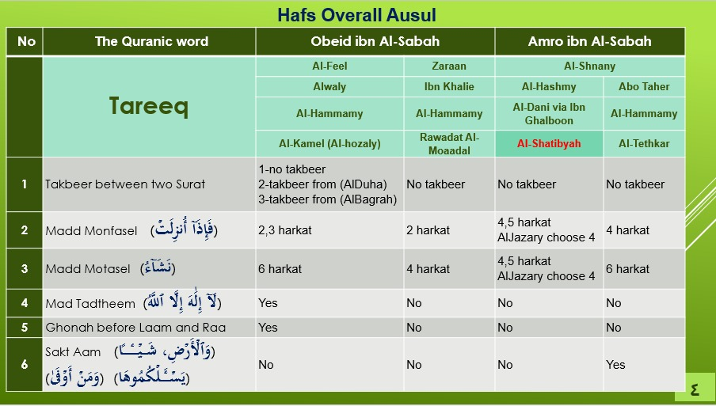
HAFS OVERALL USUL
3

Slide 5
NOTES :
JAZARI (TOYIBBAH) USED ALL ABOVE AS HIS REFERENCES
SHATIBIYAH IS THE MAIN COMPONENT OF TOYIBAH. EVERYTHING IN THIS TORIQ MUST BE READ.
TAKBEER : ALFEEL + FRIENDS.
GHUNNAH OF LAM +RO : ALFEEL + FRIENDS.
SAKT KHAS + MUTLAK : ABO TAHEER + FRIENDS.
MAD JAIS MUNFASSIL – 2 HARAKAT : AL FEEL + FRIENDS ZURAAN + FRIENDS.
4

Slide 6
GENERAL RULES AND DIFFERENCES
 | SYATIBIBI | JAZARI (TOYIBBAH)
AL TAKBIR READ لاإله إلا اللّه واللّه أكبر OR اللّه أكبر OR لاإله إلا اللّه واللّه أكبر وللّه الحمد | NO TAKBIR | DURING KHATAM AL-QURAN (TAKBIR KHAS). TAKBIR EVERY SURAH (TAKBIR AM) FOLLOWED BY BASMILLAH.
MAD JAIZ MUNFASSIL | 4/5 HARAKAT | 4 OR 2 4 TAKES PREFERENCE IN READING FOLLOWED BY 2
MAD WAJIB MUTTASSIL | 4/5 | 4
IDGHAM NUN SAKINAH AND TANWIN WHEN MEET WITH LAM AND RO. | BILAGHUNNAH NO GHUNNAH | GUNNAH 2 HARAKAT
5

Slide 7
SAKT 2 HARAKAT WITHOUT TAKING BREATH, CONTINUE WITH READING | COMPULSORRY IN 4 SURAH : AL KAF YASSIN MUTAFFIFIN AL QIYAMAH | NO SAKT ON 4 SURAH :
READING IZHAR HURUF NUN AT NUN ن AND س | IZHAR IF CONTINUE | IZHAR OR IDGHAM IF CONTINUE
WE WILL LOOK AT THE DETAILS OF EVERY WORD THAT HAS DIFFERENCES IN RIWAYAT HAFS WITH THE 2 TORIQ IN MY 3RD PRESENTATION.
WE HAVE AN OVERVIEW OF THE 10 QIROAT.
6

Slide 8
QIROAT/RIWAYAT | SHATIBI | JAZARI (TOYIBBAH)
1) QIROAT NAFIQ RIWAYAT QOLOON WARSH - ASHABANI - AZRAQ | QOLOON : BILAGHUNNAH FOR “NUN MATI” AND TANWIN WHEN MEET LAM AND RA. 2 HAMZAH MEET IN 1 SENTENCE HAVE IDHOL. WARSH (ASHBAHANI) : BILAGHUNNAH FOR “NUN MATI” AND TANWIN WHEN MEET LAM DAN RA. READ MAD WAJIB MUTTASIL AND MAD JAIS MUNFASIL 6 HARAKAT. WARSH (AZRAQ) : BILAGHUNNAH FOR “NUN MATI” AND TANWIN WHEN MEET LAM AND RA. READ MAD WAJIB MUTTASIL AND MAD JAIS MUNFASIL 6 HARAKAT. | QOLOON : GHUNNAH (DENGUNG) FOR “NUN MATI” AND TANWIN WHEN MEET LAM AND RA. NO IDHOL FOR 2 HAMZAH IN 1 SENTENCES. IMALAH يس ي TAKLIL ها يا ASHABANI : GHUNNAH (DENGUNG) FOR “NUN MATI” AND TANWIN WHEN MEET LAM AND RA. READ MAD JAIZ MUNFASIL 2 OR 4 HARAKAT. AZRAQ : GHUNNAH (DENGUNG) FOR “NUN MATI” AND TANWIN WHEN MEET LAM AND RA. READ MAD JAIZ MUNFASIL 2 OR 4 HARAKAT.
2) QIROAT IBNU KATHIR RIWAYAT AL-BAZZI QUNBUL | AL-BAZZI : BILAGHUNNAH FOR “NUN MATI” AND TANWIN WHEN MEET LAM AND RA. QUNBUL : TASHIL AND IBDAL. | AL-BAZZI : GHUNNAH (DENGUNG) FOR “NUN MATI” AND TANWIN WHEN MEET LAM AND RA. QUNBUL : TASHIL, IBDAL AND 3RD WAJAH DELETE 1ST HAMZAH.
3) QIROAT ABU AMRU RIWAYAT AD-DURI AS-SUSI | BILAGHUNNAH FOR “NUN MATI” AND TANWIN WHEN MEET LAM AND RA. TAQLIL | GHUNNAH (DENGUNG) FOR “NUN MATI” AND TANWIN WHEN MEET LAM AND RA. FATHAH TASHIL AND IMALAH AD DUNYA.
4) QIROAT IBNU AMIR RIWAYAT HISYAM IBNU ZAKWAN | HISYAM : NO SAKTAH. BILAGHUNNAH FOR “NUN MATI” AND TANWIN WHEN MEET LAM AND RA. IBNU ZAKWAN : READ MUNFASIL 4 HARAKAT. | HISYAM : HAVE SAKTAH KHAS AND MUTLAK. READ 2 HARAKAT. ZAKWAN : READ MUNFASIL 6 HARAKAT. SAKTAH FOR KHAS.
5) QIROAT AASIM RIWAYAT SYU'BAH HAFS | SYUKBAH : READ MAD JAIZ MUNFASSIL 4/5 HARAKAT. ADDING FATEH ADDING EMALHA ADDING EDGHAM. HAFS : READ MAD WAJIB MUTTASSIL 4/5 HARAKAT READ لاإله إلا اللّه واللّه أكبر OR اللّه أكبر OR لاإله إلا اللّه واللّه أكبر وللّه الحمد NO TAKBIR | SYUKBAH : MAD JAIZ MUNFASSIL 4 OR 2. 4 TAKES PREFERENCE IN READING FOLLOWED BY 2. HAS IMALAH IN (بلي ـــــ يا بشري). HAS FATAHAH IN (سوي ــــــ سدي ــــــ رمي). HAS IZHAR IN (اركبب معنا) & (يلهث ذلك). HAFS : READ MAD WAJIB MUTTASSIL 4 HARAKAT. DURING KHATAM AL-QURAN (TAKBIR KHAS). TAKBIR EVERY SURAH (TAKBIR AM) FOLLOWED BY BASMILLAH.
7

Slide 9
6) QIROAT HAMZAH AL-KUFI RIWAYAT KHALAF KHALLAD | KHALAF : MUTTASIL DAN MUNFASIL NO SAKTAH. KHALLAD : READ MAD LIN MAHMUZ. READ WHAT APPEAR IN QURAN. | KHALAF : HAVE SAKTAH. KHALLAD : READ MAD LIN MAHMUZ 4 HARAKAT.
7) AL-KISAEI AL-AL KUFI - ABU AL-HARITH - AD-DURI | ABU AL-HARITH : BILAGHUNNAH FOR “NUN MATI” AND TANWIN WHEN MEET LAM AND RA. AD-DURI : GHUNNAH (DENGUNG) FOR “NUN MATI” AND TANWIN WHEN MEET WAU AND YA. | GHUNNAH (DENGUNG) FOR “NUN MATI” AND TANWIN WHEN MEET WAU AND YA.
8) ABU JA'FAR AL-MADANI - IBNU WARDAN - IBNU JAMMAZ | IBNU WARDAN : BILAGHUNNAH FOR “NUN MATI” AND TANWIN WHEN MEET LAM AND RA. IBNU JAMMAZ : NO ISYMAM FOR MALAIKAH (ملائكه) SENTENCES. | IBNU WARDAN : HAVE GHUNNAH. IBNU JAMMAZ : HAVE ISYMAM.
9) YA'QUB AL-BASRI - RUWAIS - RAUH | RUWAIS : BILAGHUNNAH FOR “NUN MATI” AND TANWIN WHEN MEET LAM AND RA. RAUH : IDGHAM KABIR = SUSI | RUWAIS : BILAGHUNNAH FOR “NUN MATI” AND TANWIN WHEN MEET LAM AND RA. HAVE IDGHAM KABIR.
10) KHALAF AL-ASYIR - ISHAQ - IDRIS | NO SAKTAH | HAVE ALL SAKTAH KHAS AND MUTLAK.
WE NOW LOOK AT HAFS TORIQ JAZARI (TOYIBBAH) AND READ PAGE 3 OF SURAH AL BAQARAH. WE HAVE READ PAGE 1 AND 2.
I HAVE HIGHLIGHTED THE DIFFERENCES BETWEEN 2 TORIQ.
8

Slide 10

إِنَّ ٱلَّذِينَ كَفَرُواْ سَوَآءٌ عَلَيۡهِمۡ ءَأَنذَرۡتَهُمۡ أَمۡ لَمۡ تُنذِرۡهُمۡ لَا يُؤۡمِنُونَ ٦ خَتَمَ ٱللَّهُ عَلَىٰ قُلُوبِهِمۡ وَعَلَىٰ سَمۡعِهِمۡۖ وَعَلَىٰٓ أَبۡصَٰرِهِمۡ غِشَٰوَةٞۖ وَلَهُمۡ عَذَابٌ عَظِيمٞ ٧ وَمِنَ ٱلنَّاسِ مَن يَقُولُ ءَامَنَّا بِٱللَّهِ وَبِٱلۡيَوۡمِ ٱلۡأٓخِرِ وَمَا هُم بِمُؤۡمِنِينَ ٨ يُخَٰدِعُونَ ٱللَّهَ وَٱلَّذِينَ ءَامَنُواْ وَمَا يَخۡدَعُونَ إِلَّآ أَنفُسَهُمۡ وَمَا يَشۡعُرُونَ ٩
Madd
Ghonah
Sakt
9

Slide 11
فِي قُلُوبِهِم مَّرَضٞ فَزَادَهُمُ ٱللَّهُ مَرَضٗاۖ وَلَهُمۡ عَذَابٌ أَلِيمُۢ بِمَا كَانُواْ يَكۡذِبُونَ ١٠ وَإِذَا قِيلَ لَهُمۡ لَا تُفۡسِدُواْ فِي ٱلۡأَرۡضِ قَالُوٓاْ إِنَّمَا نَحۡنُ مُصۡلِحُونَ ١١ أَلَآ إِنَّهُمۡ هُمُ ٱلۡمُفۡسِدُونَ وَلَٰكِن لَّا يَشۡعُرُونَ ١٢ وَإِذَا قِيلَ لَهُمۡ ءَامِنُواْ كَمَآ ءَامَنَ ٱلنَّاسُ قَالُوٓاْ أَنُؤۡمِنُ كَمَآ ءَامَنَ ٱلسُّفَهَآءُۗ أَلَآ إِنَّهُمۡ هُمُ ٱلسُّفَهَآءُ وَلَٰكِن لَّا يَعۡلَمُونَ ١٣
Madd
Ghonah
Sakt
10

Slide 12
وَإِذَا لَقُواْ ٱلَّذِينَ ءَامَنُواْ قَالُوٓاْ ءَامَنَّا وَإِذَا خَلَوۡاْ إِلَىٰ شَيَٰطِينِهِمۡ قَالُوٓاْ إِنَّا مَعَكُمۡ إِنَّمَا نَحۡنُ مُسۡتَهۡزِءُونَ ١٤ ٱللَّهُ يَسۡتَهۡزِئُ بِهِمۡ وَيَمُدُّهُمۡ فِي طُغۡيَٰنِهِمۡ يَعۡمَهُونَ ١٥ أُوْلَٰٓئِكَ ٱلَّذِينَ ٱشۡتَرَوُاْ ٱلضَّلَٰلَةَ بِٱلۡهُدَىٰ فَمَا رَبِحَت تِّجَٰرَتُهُمۡ وَمَا كَانُواْ مُهۡتَدِينَ ١٦
Madd
Ghonah
Sakt
11

Slide 13
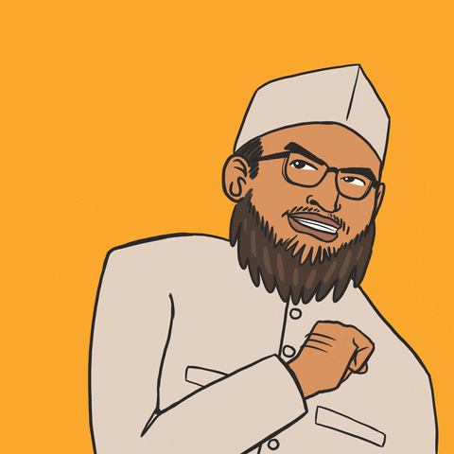
WE WILL MEET AGAIN NEXT TIME. INN SHAA ALLAH
THANK YOU
TERIMA KASIH

